Slide 1



Analisis Churn dalam Pemasaran
Stage 2 Identify
Tim Kamboja:
Azis Rahmanto
Fahmi Ramadhan Putra
Ridho Ardia Rahman
Umi Purnamasari

Slide 2


Strategy
Problem Understanding
Data Collection
Exploratory Data Analysis
Visualization
Evaluation Matrix
Develop Modelling
Data Pre Processing
Understanding Insights from EDA
Initiatives

Slide 3



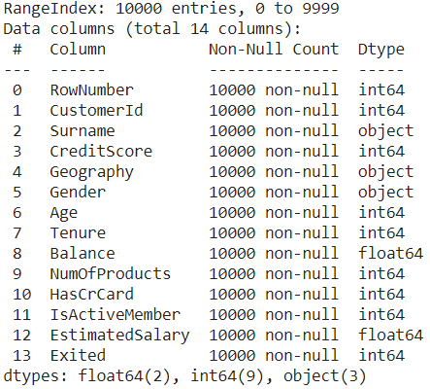

Strategy
1
Berhenti berlangganan
2
Tidak memperbarui langganan
3
Berpindah ke kompetitor
4
Penutupan akun
VS
Analis Churn dan Membandingkan dengan KPI
Data Analysis & Modelling
Strategic Initiatives

Slide 4

Terima Kasih
Send it to us! We hope you learned something new.

